Slide 1
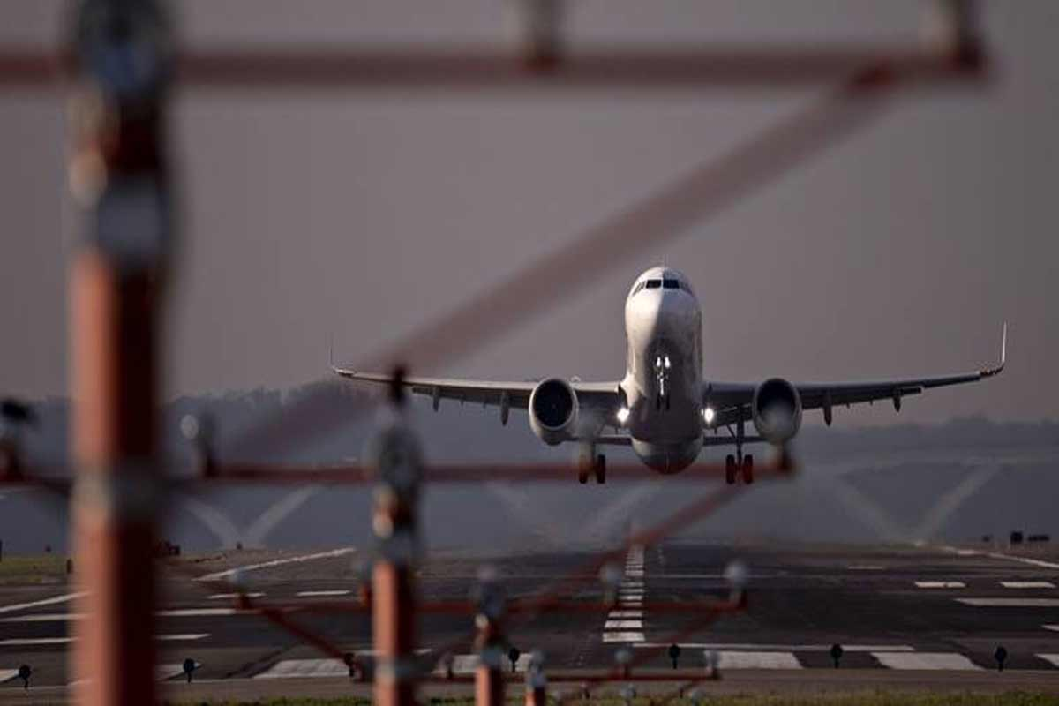
FLIGHT FARE CASE STUDY
FLIGHT FARE CASE STUDY
A RESEARCH PROJECT by
NANDINI CHAKRABORTY

Slide 2
CONTENTS
CASE STUDY
OBJECTIVES
DATA ANALYSIS
IMPORTANT FACTORS
TABLE ANALYSIS
DATA ANALYSIS IN BRIEF WITH VIZUALIZATION.
FINDINGS

Slide 3
CASE STUDY
This consists of 1 dataset which consists of 9 tables which have data of leading airlines companies’ destination, source, route, arrival time, departure time , flight hour duration, number of stops , additional information and prices .
This dataset has 10684 rows.

Slide 4
OBJECTIVES
ANALYSE FLIGHT TICKET PRICES FOR GIVEN AIRLINES, SOURCES OF FLIGHTS, DESTINATIONS OF FLIGHTS, STOPS OF THR FLIGHTS.
PUBLISH THE RESULT BASED ON DATA ANALYSIS.

Slide 5
DATA ANALYSIS
FOR DATA ANALYSIS VARIOUS FACTORS AFFECTING BUISNESS THE DIFFERENT IMPOTANT ATTRIBUTES ARE LISTED OUT TO FIND OUT OUR OBJECTIVES.
HERE THOSE ARE AIRLINE, DESTINATION, SOURCE, NUMBER OF STOPS, PRICE.
IN THIS CASE THE ONLY TABLE IS DATA_TRAIN WITH OVER 1,00,000 ROWS.

Slide 6
IMPORTANT FACTORS TO OPTIMIZE BUISNESS
TO FIND OUT AIRLINE WISE MAX FLIGHT FARE FOR EACH AIRLINE BASED ON FLIGHT DURATION.
TO FIND OUT MAX FLIGHT FARE FOR EACH AIRLINE BASE ON NUMBER OF STOPS OF THE FLIGHS.
TO FIND OUT MAX AND MEAN FLIGHT FARE FOR EACH AIRLINE
TO FIND OUT MAX AND MEAN FLIGHT FARE FOR SPECIFIC SOURCE AND DESTINATION OF FLIGHTS.
TO FIND OUT EACH SOURCE TO DESTINATION WISE MAX AND MEAN FLIGHT FARE,
TOP 5 DESTINATIONS IN TERMS OF DESTINATIONS.

Slide 7
TABLE ANALYSIS
THE DATASET CONSIST HERE ONLY ONE TALBLE.
THE DATASET CONSISTS OF 6 DISTINCT AIRLINES, UNIQUE COMBINATIONS OD SOURCE AND DESTINATIONS, ROUTES OF THE FLIGHTS, NUMBER OF STOPS OF FLIGHTS – THESE ATTRIBUTES HAVE MAINLY HAVE BEEN USED FOR THIS PERTICULAR ANALYSIS.
HERE WE HAVE DATA FOR MAINLY 6 DIFFERENT CITIES.

Slide 8
DATA ANALYSIS IN BRIEF WITH VIZUALIZATION ARE SHOWN IN THE NEXT SLIDES.

Slide 9
NUMBER OF FLIGHT FROM DISTINCT DESTINATIONS HAVE BEEN SHOWN

Slide 10
WHEN THE FLIGHT HOUR IS MORE THAN 7.5 AND MORE THAN 24 HOURS ,THE AIRLINES WHICH HAVE CHARGED MAXIMUM PRICE ARE SHOWN.

Slide 11
MAXIMUM PRICE CHARGED BY EACH AIRLINES HAVE BEEN SHOWN IN THE NEXT SLIDE WHEN THEY HAVE NO STOPS AND ONE STOP DURING FLIGHT HOURS

Slide 12
DIFFERENCE OF MAX AND MIN FLIGHT FARE FOR EACH UNIQUE COMBINATION FOR SOURCE AND DESTINATION HAVE BEEN SHOWN AGAIN MAX AND MEAN FLIGHT FARE FOR EACH AIRLINES HAVE BEEN SHOWN.

Slide 13
NUMBER OF MAXIMUM AND MINIMUM PRICE FOR EACH UNIQUE SOURCE TO DESTINATIONS.

Slide 14
TOP 5 DESTINATIONS BASED ON AVERAGE FLIGHT FARE HAS BEEN SHOWN .

Slide 15
FINDINGS
NEW DELHI, COCHIN, BANGALORE, DELHI, HYDRABAAD ARE THE TOP MOST DESTINATIONS ACCORDING TO AVERAGE FLIGHT PRICES.
THE UNIQUE SOURCE DESTINATION COMBINATIONS WHICH HAVE MOST DIFFERENCE IN TERMS OF MAX AND MIN PRICE ARE RESPECTIVELY –BANGALORE TO NEW DELHI, KOLKATA TO BANGALORE, DELHI TO COCHIN, CHENNAI TO KOLKATA , MUMBAI TO HYDRABAD.
THE AIRLINES WHICH HAS MOST DIFFERENCE IN MAX AND MIN PRICE ARE RESPECTIVELY INDIGO, AIR INDIA, JET AIRWAYS, SPICEJET.
FLIGHT HOUR WISE AND NUMBER OF STOPS WISE WHICH AIRLINES CHARGE MOST FLIGHT PRICE HAVE BEEN SHOWN IN PERCENTAGES IN THE UPCOMING SLIDES.

Slide 16
THANK YOU

